Slide 1


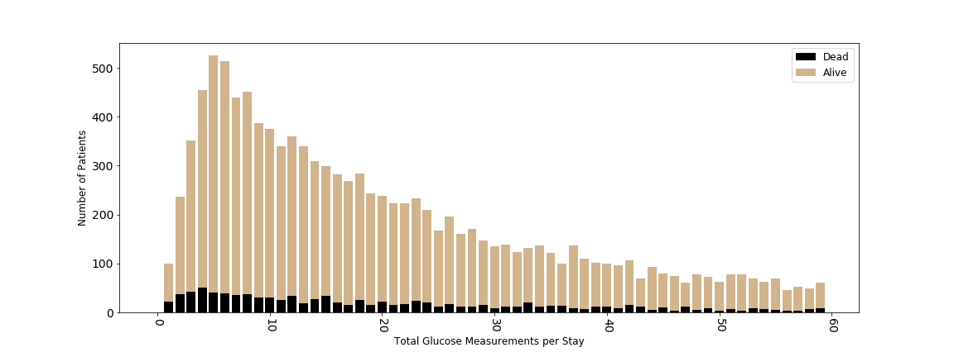
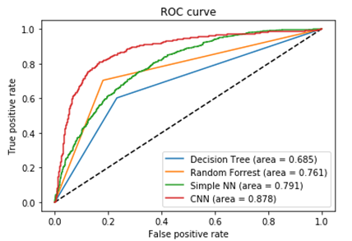
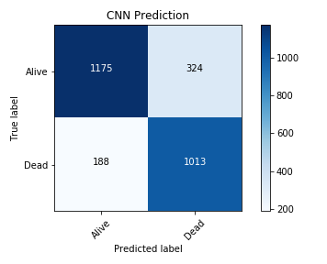
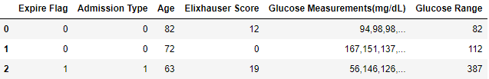
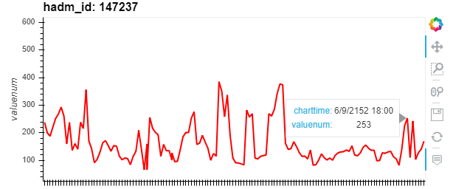
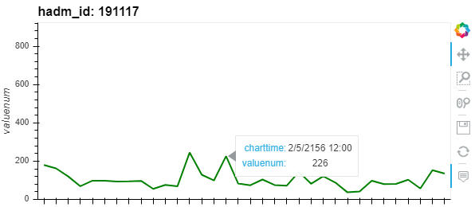
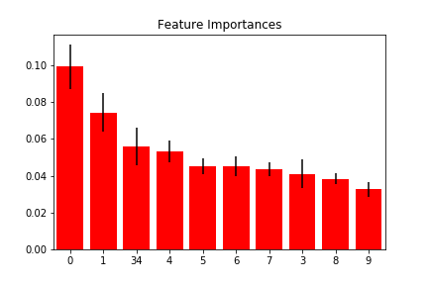
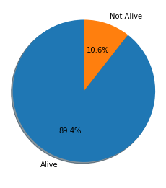
Predicting Mortality of Diabetic ICU Patients
Ian Wittler | Hood College of Frederick Maryland
Abstract
Preprocessing
Model Implementation
Diabetes mellitus is a significant health problem that affects a large majority of patients. In many cases, diabetes is a gateway to more harmful health complications which are associated with longer hospital stays and increased mortality rates. In this paper, the MIMIC-III data set [1] is used to develop and train models that aim to predict mortality of diabetic patients. The models are driven by algorithms including: decision trees, random forests, and neural networks. The best performing model, the convolutional neural network, produced a 0.878 AUC score. In attempt to create a simplified model, the input features for were evaluated and reduced to 5 variables: admission type, age, Elixhauser score (comorbidity score), blood glucose measurements, and blood glucose range. By focusing strictly on diabetic patients, it can be assured that each patient's blood glucose levels were monitored throughout their stay.
Four types of modeling algorithms were used:
Trained Decision Tree
Trained Random Forest
Feed Forward Neural Network
Convolutional Neural Network (CNN)
Results
Figure 3: Glucose Measurements per Stay
In the data, the amount of blood glucose measurements varied widely between different patients seen in figure 3. To create a more structured input matrix, the blood glucose measurements of each patient was incorporated by simply using the last 30 measurements before discharge or death, as deemed to be the most impactful measurements.
Data Description
Figure 7: AUC Results
Figure 8: CNN Confusion Matrix
Visualization
The four model were evaluated using AUC. The CNN produced the best results with a 0.878 score. The improvement in score obtained by using a CNN model which can detect different blood glucose patterns suggest that the measurements can serve as an important factor in modeling diabetic patient mortality.
In the data set, 20% (11820/58976) of all patients had diabetes ICD9 codes. Figure 2 breaks down the diabetic patients into two class: alive (89.4%) and not alive (10.6%). These classes represent the feature which will be predicted from the models that are created. The imbalance of classes played a role into how the data was split and sampled. Another visualization tool, used for graphing patient’s blood glucose measurements, can be seen in figure 1.
By observing these graphs, changes
in patient’s blood glucose values
are noticeable. With the above figure,
the red line is used to represent
dead patients and the green line to
represent alive patients.
Figure 4: Three Sample Rows of Input Features
After preprocessing and feature reduction was performed, the final data frame consisted of 5 variables (represented in figure 4). Additionally, feature importance for each of these variables was calculated (figure 5) to determine the driving factors of the models. The Elixhauster
score was the most
impactful feature
followed by age and then
a steady drop off for the
remaining features.
Future Work
Determining how blood glucose measurements can impact other hospital events such as a patient receiving medication, going into surgery, etc., could prove to be an interesting follow up study. This information could help to understand:
1. What glucose treatments are most desired for positive outcomes and 2. How glucose measurement can be used to predict different events.
Figure 1: Two Patient Glucose Measurements
Acknowledgements and References
I would like to express my very great appreciation to Dr. Liu, Xinlian, Dr. Dong, Aijuan,, Dr. Darby, Miranda, Dr. Kennedy, Linda, and Dr. Campbell, Andrew for their direction and expertise which positively impacted the quality of research.
Figure 5: Feature Importance
Data Splitting
Before modeling the data, over-sampling was performed on the patients who did not live along with under-sampling on the patients who lived. The resulting data was split 70/15/15 training, validation, and testing.
[1] Alistair E.W. Johnson et al. 2016. MIMIC-III, a freely accessible critical care database. (May 2016).
[2] Rajsavi S. Anand et al. 2018. Predicting Mortality in Diabetic ICU Patients Using Machine Learning and Severity Indices. (May 2018).
Figure 2: Mortality Distribution

